Slide 1
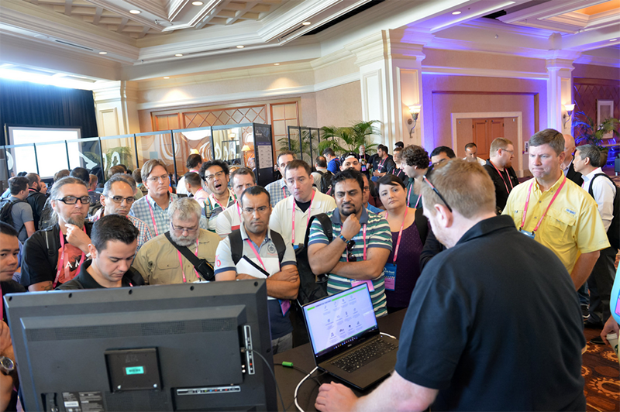
What is it again please?
Independent researchers and the open source community will showcase their latest open-source tools and products!
Arsenal provides live tool demonstrations in an open, conversational environment where presenters are able to interact with attendees to provide a hands-on experience.

Slide 2
Arsenal Video
https://drive.google.com/file/d/0BzWLgIKAKAAAU1lJY1lJUGhjaTA/view
Notes:
https://drive.google.com/file/d/0BzWLgIKAKAAAU1lJY1lJUGhjaTA/view

Slide 3
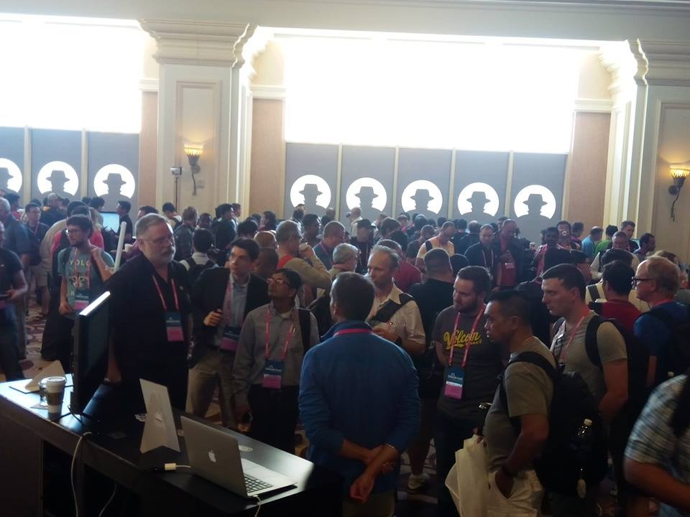
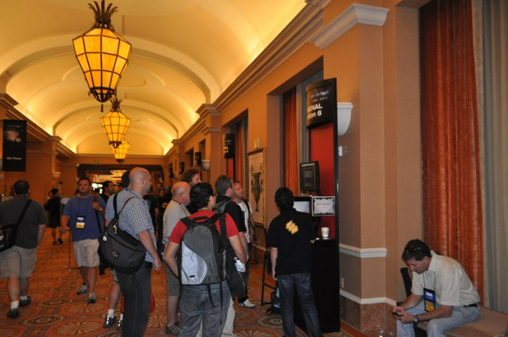
Evolution
Notes:
USA started in 2011 followed by Europe in 2012 and then ASIA in 2014

Slide 4
Very diverse topics
Android, iOS and Mobile Hacking
Code Assessment
Cryptography
Data Forensics and Incident Response
Exploitation and Ethical Hacking
Internet of Things
Malware Defense
Malware Offense
Network Attacks
Network Defense
Vulnerability Assessment
Web AppSec
OSINT - Open Source Intelligence
Reverse Engineering
Hardware/Embedded
Human Factors

Slide 5
Why it should not be missed?
Straight talk, no scan, no goodies, nothing to buy…
Got some Fresh oxygen between Briefings and Business Hall
When talking about their tools developers are very open and not shy sharing the reality of their status and capabilities
They often know very well the commercial space to compare with so good place to talk with expert on the field they present on

Slide 6

Collateral Benefits
Faster Improvements,
Quicker come to light
Quality improvement
Notes:
No Stereotype of Developers nor Visitor
More and more diverse in term of Geographic origin (was originally mainly US people)

Slide 7
These people will save the world one day!
BH Asia 2017 Opening talk by Halvar Flake, “Why we are not building a defentable Internet?”
- > Because Security vendors don’t listen enough to the users/customers
And what we have here?
Live feedbacks from the users to the developers – Shortest feedback loop possible!!!

Slide 8
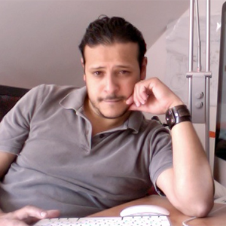
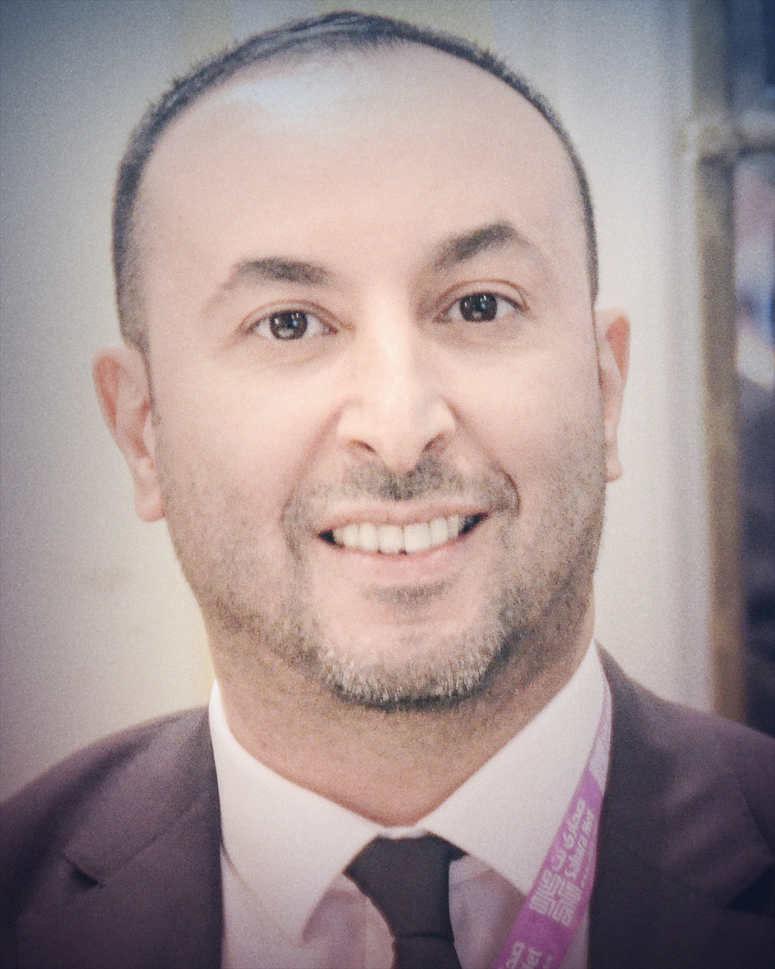
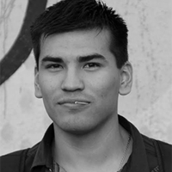
The Team
@toolswatch
@rachidharrando
@MaxiSoler

Slide 9
Thank You

