Slide 1

Welcome to Day Zero

Slide 2
Where No Person Has Gone Before:
An Oral History of Black Hat
Ping Look

Slide 3
Oh How We have Grown
1997
  Training: 0
  Presentations: 16
  Attendees: 100?
  Sponsors : 3
  Countries: 5?
  Volunteers: 10? Network?
  No such thing…56Kbps dial up baby…
2017
  Training: 73 Unique Courses
  Presentations: 200+
  Attendees: 15K+
  Sponsors: 250+
  Countries: 108
  Volunteers: 70+ and
  Network Team: 20+
Notes:
Parallel to the industry…$75B in 2015, expected to be $120B by 2020 - https://www.forbes.com/sites/stevemorgan/2015/12/20/cybersecurity%E2%80%8B-%E2%80%8Bmarket-reaches-75-billion-in-2015%E2%80%8B%E2%80%8B-%E2%80%8Bexpected-to-reach-170-billion-by-2020/#2b09c4a410c3

Slide 4
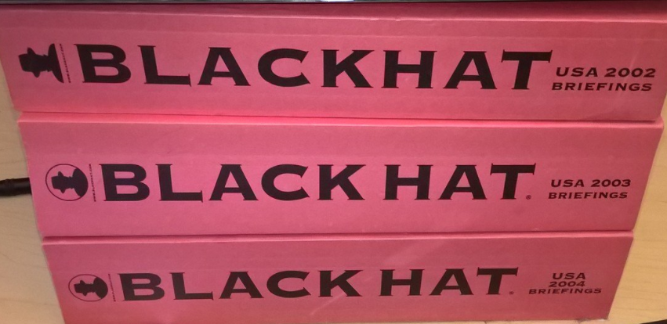
Curious Stats
Attendees: 125K+ worldwide
Miles walked: 3.3M+ miles (USA)
Paper Books: 25K lbs or 12.5 tons of printed conference proceedings (2006)…probably over 75 tons of books carried by attendees over the last 20 years
Photo courtesy of Tom Gallagher
Notes:
Paper books: 1 ream of paper is 5lbs x 5000 delegates
Miles walked 2000 steps to walk a mile, 115K attendees over the last 20 years, average 5 miles a day

Slide 5

In the beginning…
Notes:
In an age of pervasive distributed computing, the corporate design community is reaching out to hackers as a kind of unofficial vanguard of security, the underground engineers of the Internet era.
Great can come from anywhere – Jimmy Iovene
1997 was a big year. Steve Jobs returned to apple at the start of the year and Black Hat kicked off on July 9
Other anniversaries
DEF CON – 25 / 1993
Twin Peaks - 25
Bladerunner – 35 / 1982
Star Wars – 40 / 1976

Slide 6
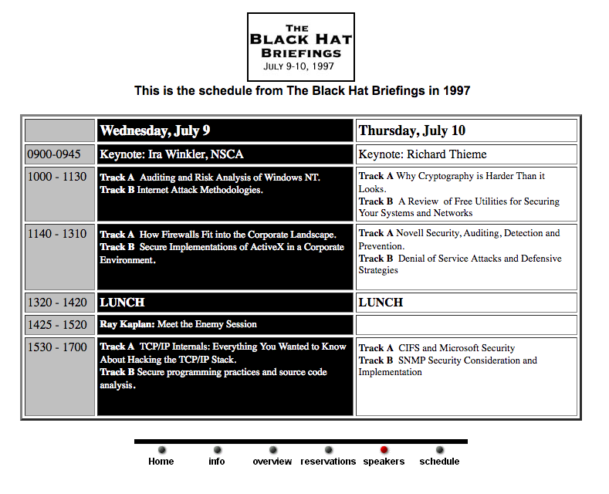
Notes:
https://www.blackhat.com/html/bh-usa-97/schedule.html

Slide 7
Milestones & Landmark Presentations
Notes:
Standout moments
Worst moment? – 2006 – when a Presenter goes missing…
Y2K/DotCom bust, 9/11, 2006, 2010
Memorable speaker moments:
Europe 2000 – I’ve never gotten so lost so fast
Japan 2005 – Dance Dance Revolution, Godzilla style
Best meals: Singapore 2000 and Japan 2008

Slide 8
About Me: Ping Look aka Crusher of Souls
Black Hat Event Director (1999-2012)
Current
  Black Hat Review Board Member
  Optiv Security
Contact
  pinglook@gmail.com
  Twitter: vlkyri

