Slide 1

Don't Panic: The Hitchhiker's Guide to Black Hat
Neil R. Wyler (Grifter)

Slide 2

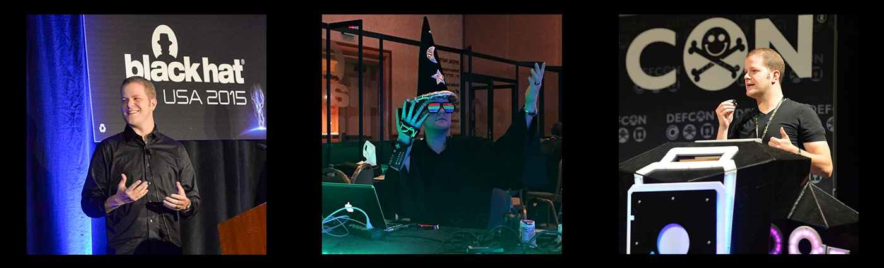
Who is this guy?
@GRIFTER801

Slide 3

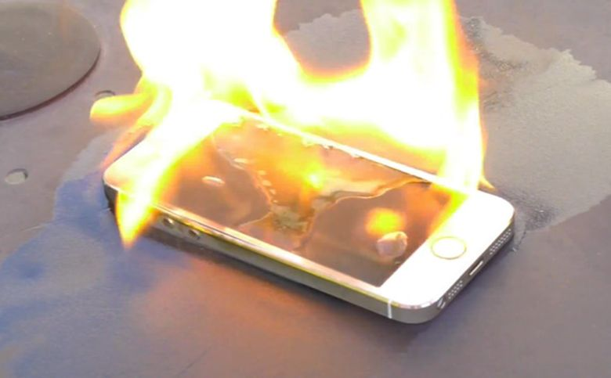


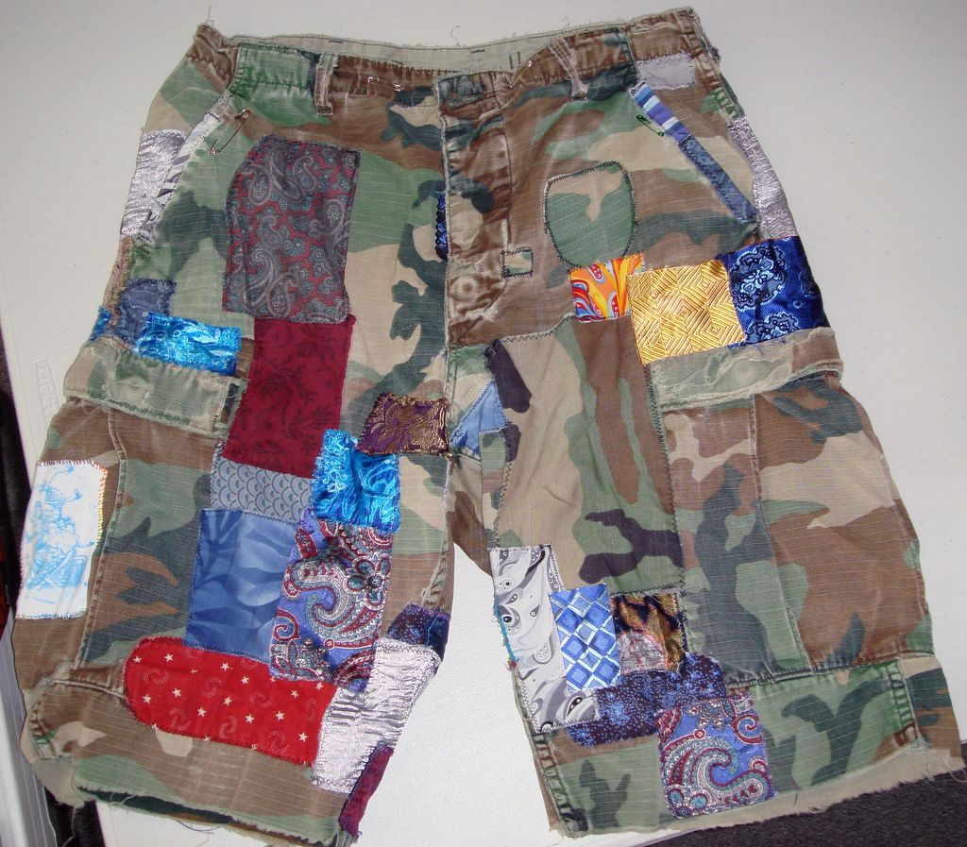
Don’t Panic
@GRIFTER801

Slide 4
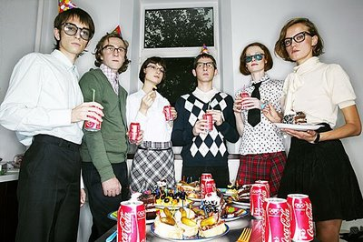


Party/Network
@GRIFTER801

Slide 5



The Expo Hall
@GRIFTER801

Slide 6
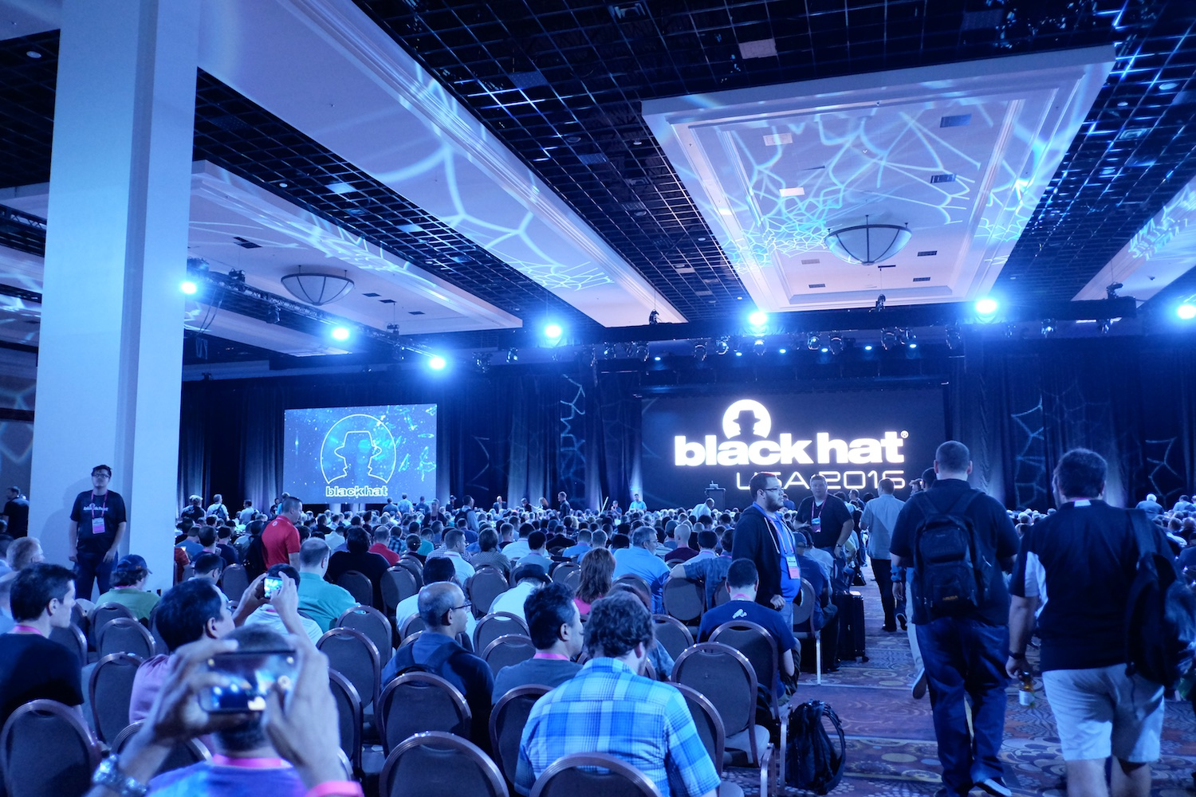
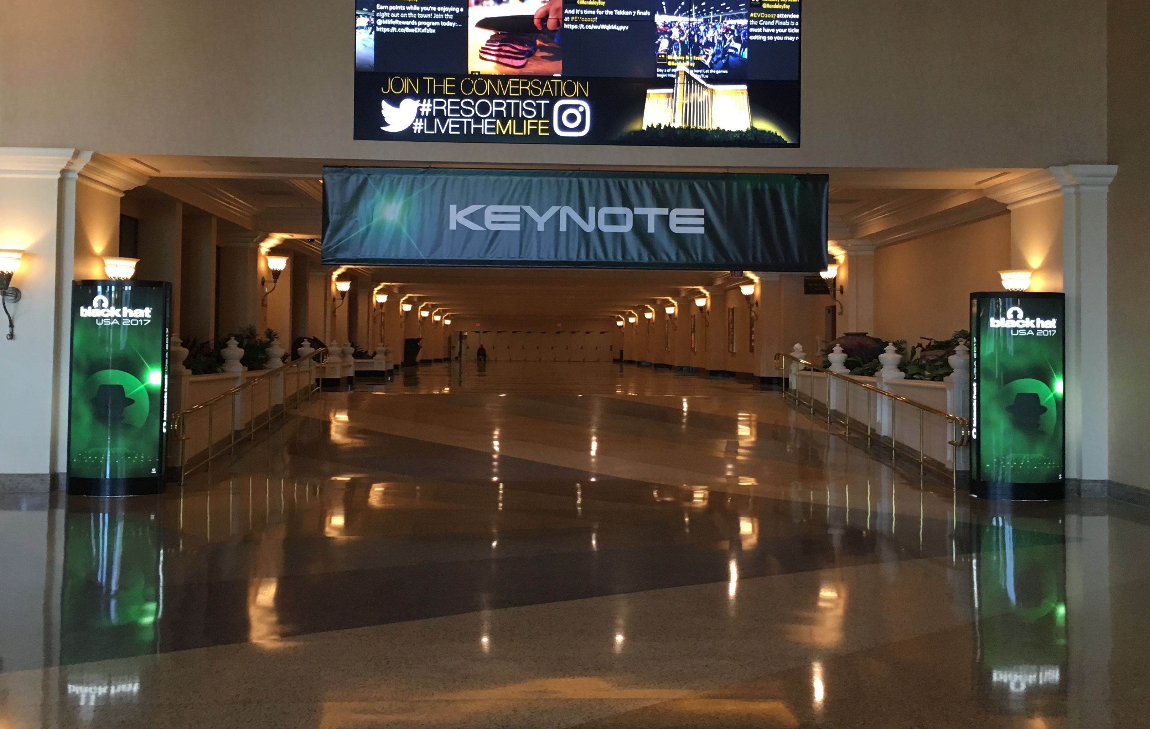
The Keynote
@GRIFTER801

Slide 7
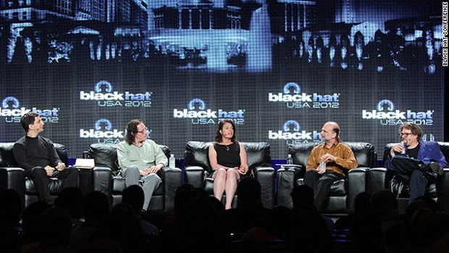

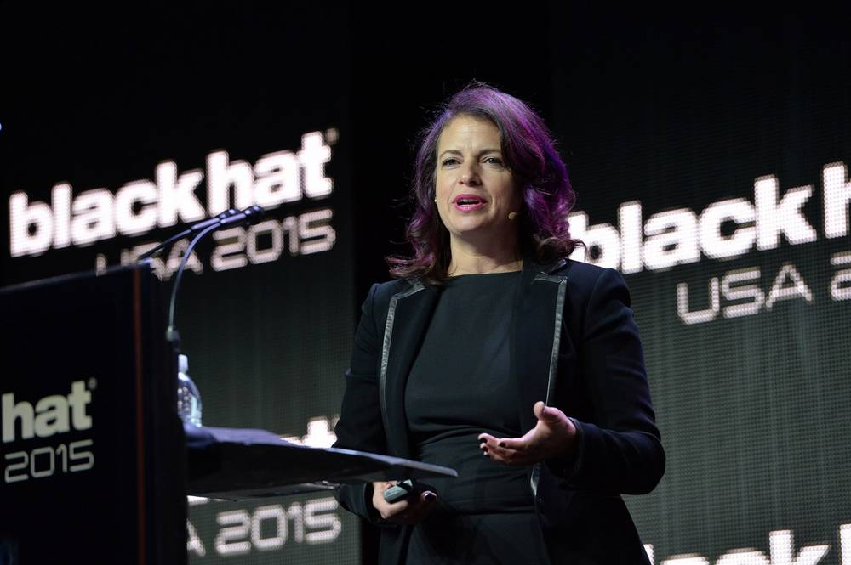
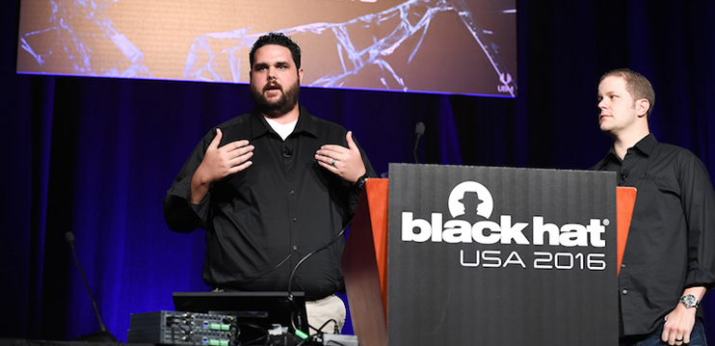
Which talks should I attend?
@GRIFTER801

Slide 8

Scratch That
@GRIFTER801

Slide 9
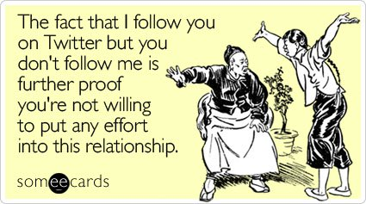

Social Media
@GRIFTER801

Slide 10

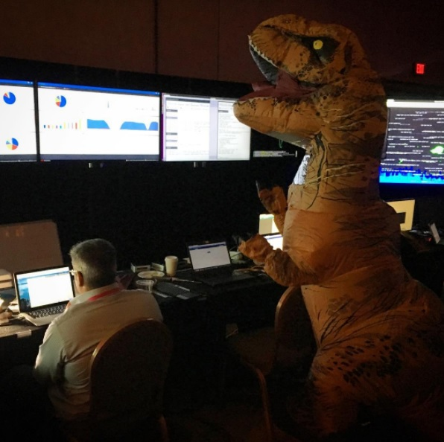
The NOC
@GRIFTER801

Slide 11


Kali Dojo
@GRIFTER801

Slide 12

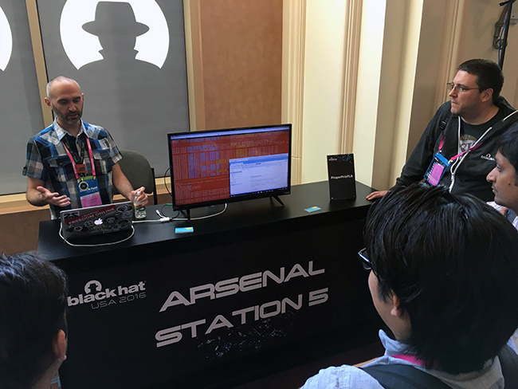

Arsenal
@GRIFTER801

Slide 13
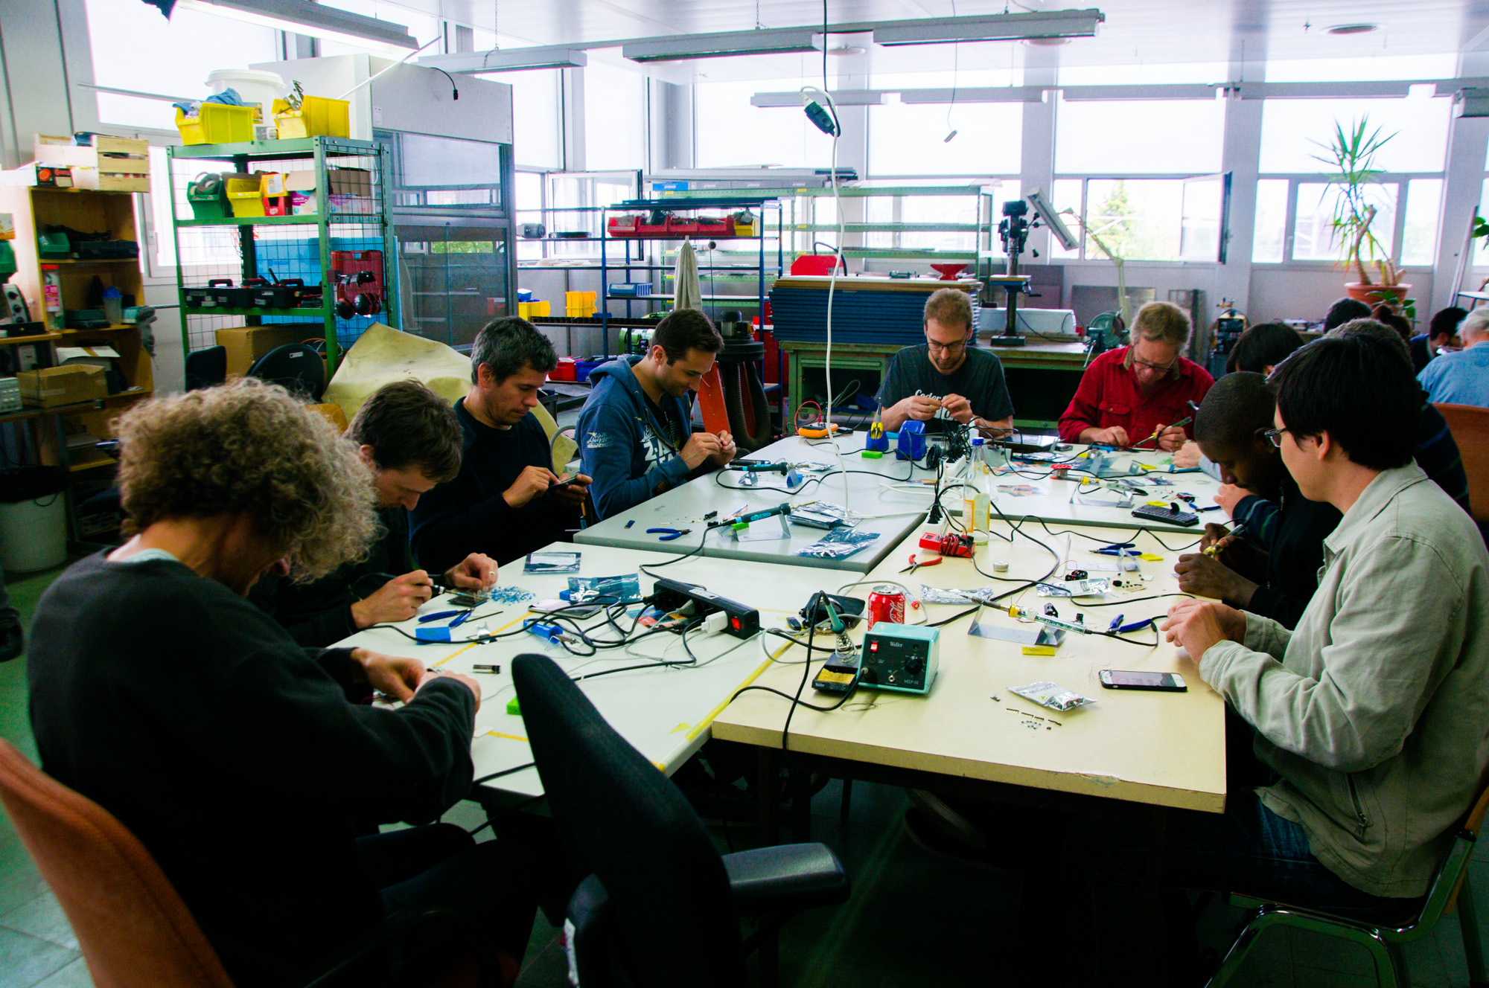



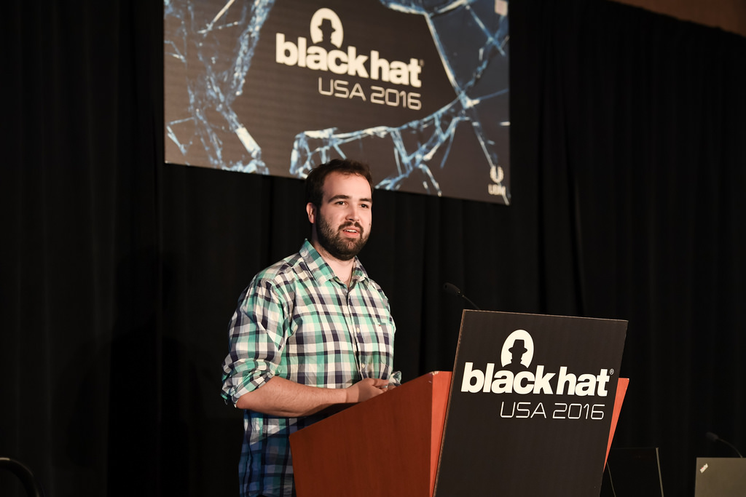
Be Part of It
@GRIFTER801

Slide 14

@GRIFTER801

