Slide 1


Slide 2

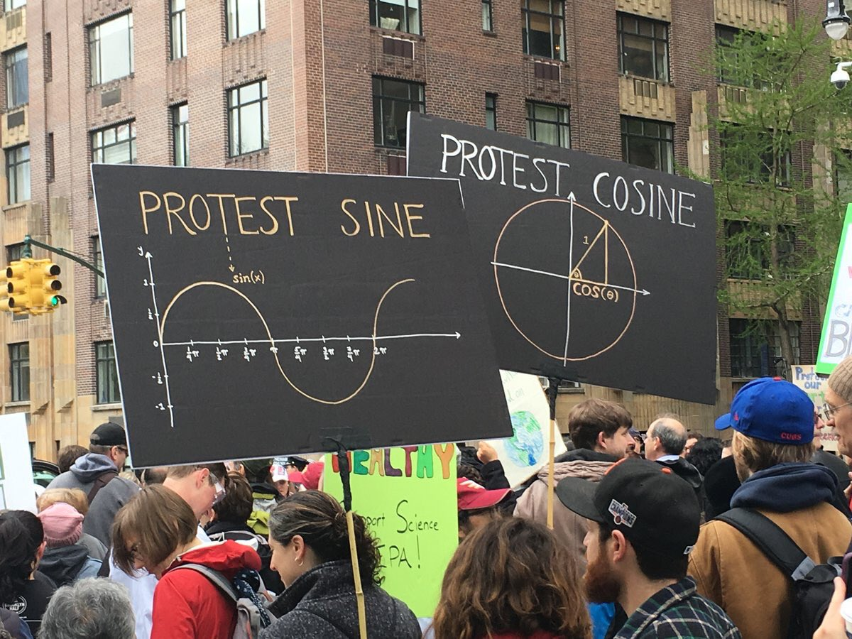
18 Tracks
117 Briefings
Record Number of
Submissions.
Notes:
Record number of submissions.

Slide 3
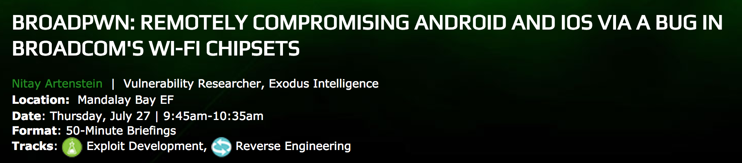
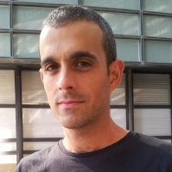
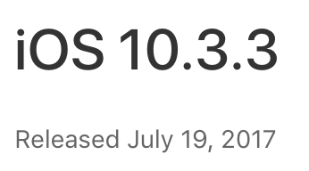
Notes:
But what happens when, underneath your heavily hardened OS, a separate chip parses all your Wi-Fi packets - and runs with no exploit mitigations whatsoever?
Meet Broadpwn, a vulnerability in Broadcom's Wi-Fi chipsets which affects millions of Android and iOS devices, and can be triggered remotely, without user interaction.

Slide 4
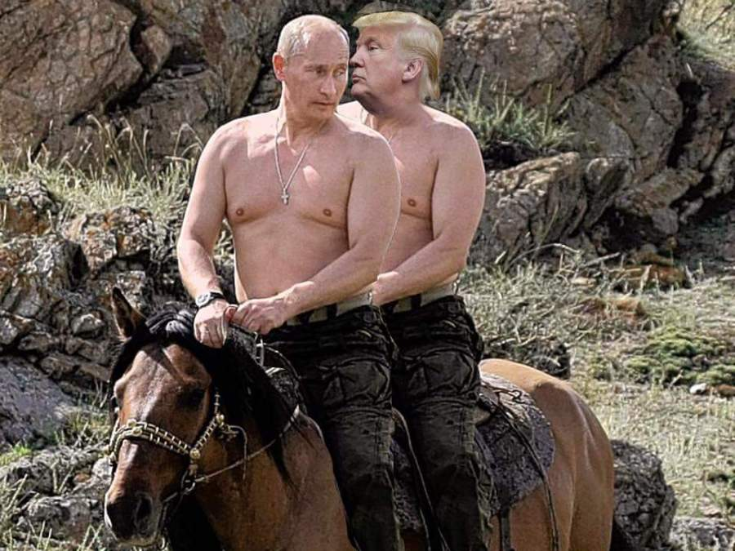
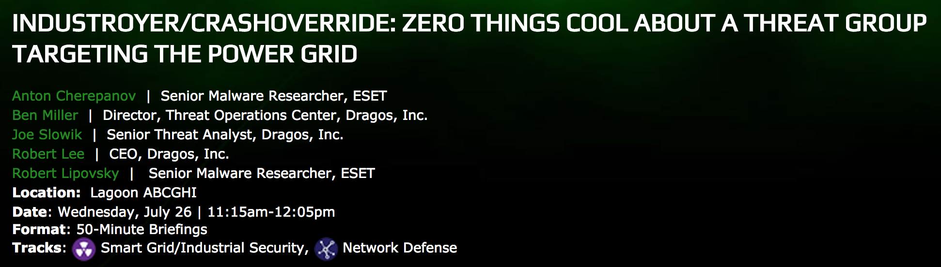
Notes:
Stuxnet, Havex and Blackenergy2: THREE ICS tailored Malware (that we know about)
ENTER CRASHOVERRIDE (where is ACID BURN?)
The cyber attack on Ukraine’s power grid on December 17th, 2016 was the second time in history a power grid had been disrupted due to a digital attack.
This talk will walk through the Ukraine 2015 and Ukraine 2016 events with a central focus on the malware, technical analysis of it, and the impact to grid operations.

Slide 5
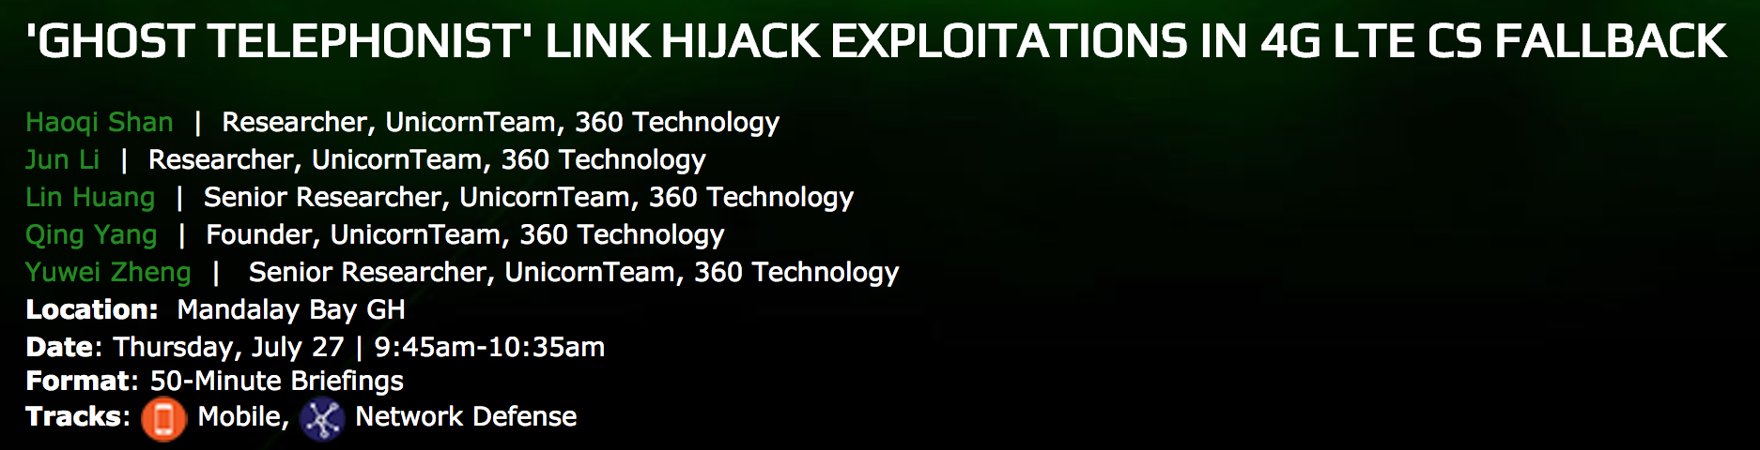
Notes:
Circuit Switched FallBack (CSFB) is a whereby voice and SMS services are delivered to LTE devices through the use of GSM
Needed because LTE is a packet-based all-IP network that cannot support circuit-switched calls. When an LTE device is used to make or receive a voice call or SMS, the device "falls back" to the 3G or 2G network to complete the call or to deliver the SMS text message.
one vulnerability in CSFB (Circuit Switched Fallback) in 4G LTE network is introduced. In the CSFB procedure, we found the authentication step is missing. The result is that an attacker can hijack the victim's communication.

Slide 6
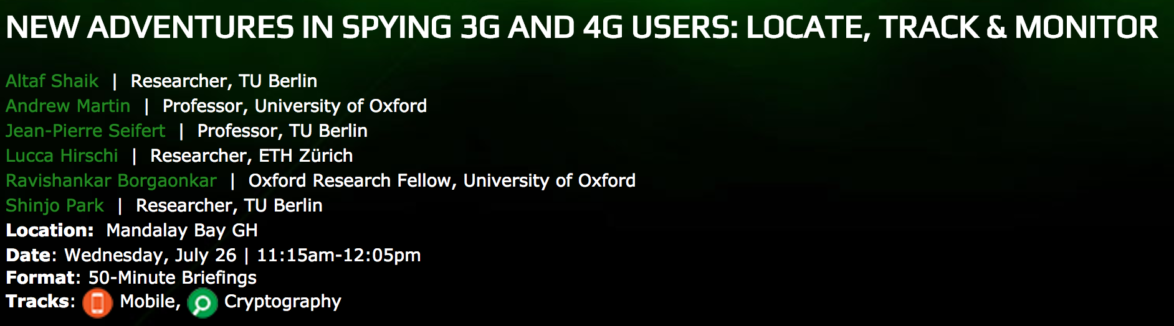
Notes:
3G/4G is open to abuse by those with Stingray. 72 agencies in 24 states. 5G Saves, giving us privacy. Oh wait, WUT? enable tracking and activity monitoring of mobile users

Slide 7
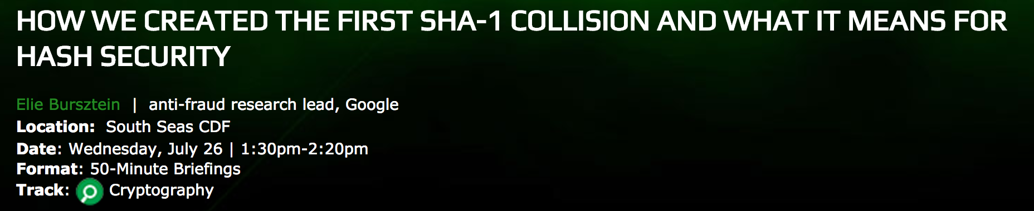
Notes:
2 Years of research, 6500 CPU years and 110 GPU years of computations. Google should have gone into Bitcoin Mining.
February 2017, the first SHA-1 collision. This collision combined with a clever use of the PDF format allows attackers to forge PDF pairs that have identical SHA-1 hashes and yet display different content.
We delve into the challenges we faced from developing a meaningful payload, to scaling the computation to that massive scale, to solving unexpected cryptanalytic challenges that occurred during this endeavor.

Slide 8
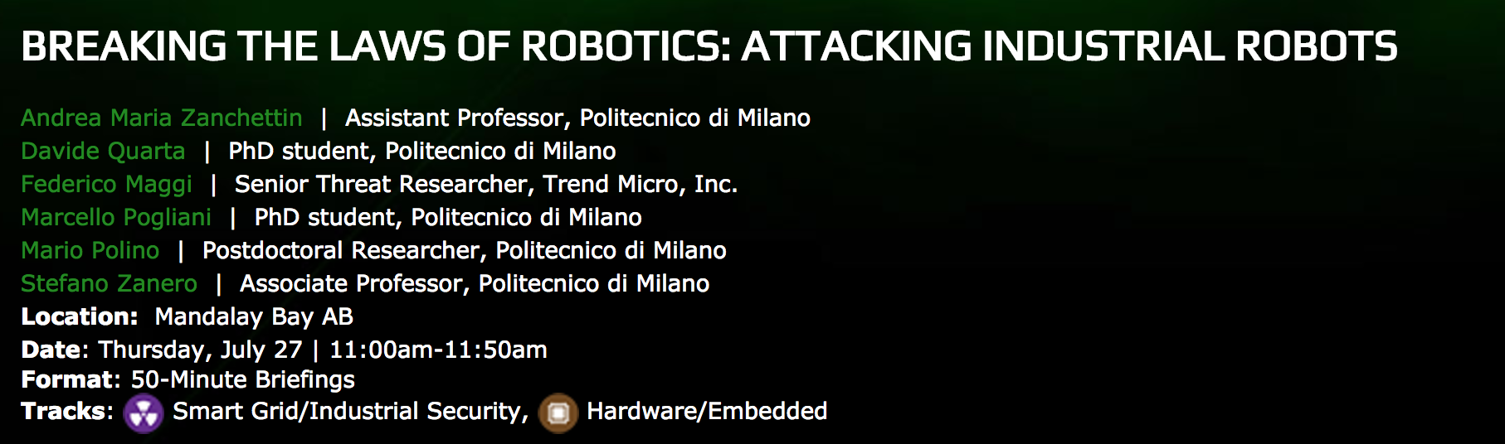
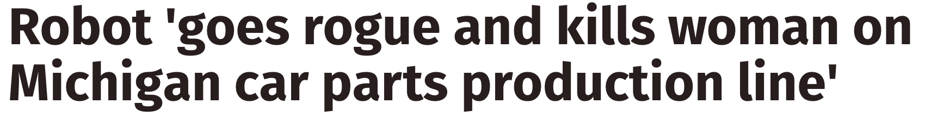
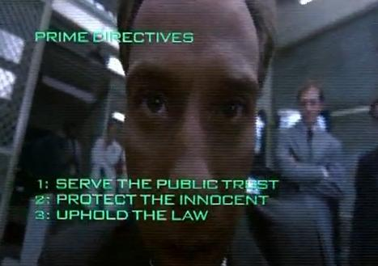
Notes:
Industrial robots must follow three fundamental laws: READ, WRITE NEVER HARM HUMANS.
Robocop and Prime Directive #4???
We will cover in-depth technical aspects (e.g., reverse engineering and vulnerability details, and attack PoCs), alongside a broader discussion on the security posture of industrial routers and robots: Why these devices are attractive for attackers? What could they achieve? Are they hard to compromise? How can their security be improved?

Slide 9
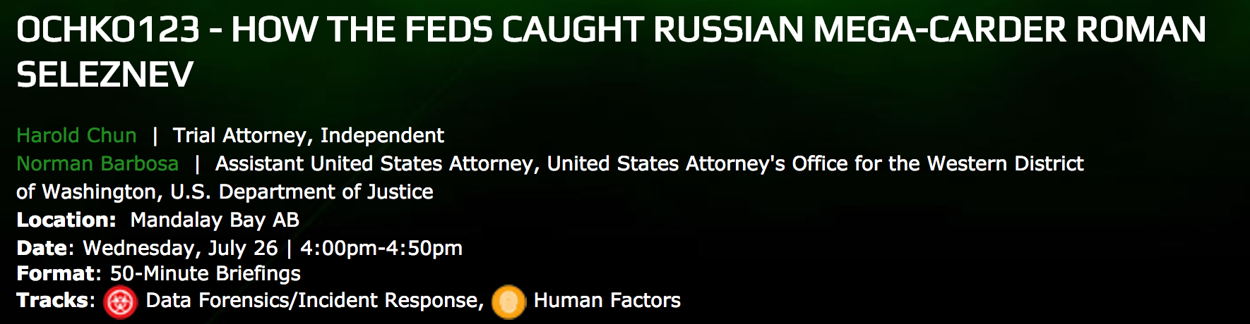
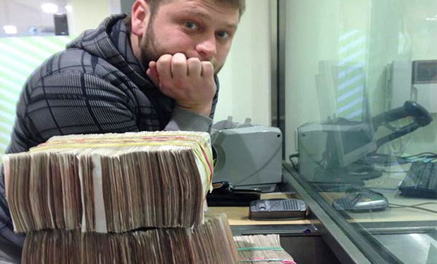
Notes:
Igor Litvak, attorney for Russian hacker Roman Seleznev, says Seleznev's life has been a series of tragedies
2.9 million unique credit card numbers in his possession. His thefts resulted in about $170m in business losses.
How did the Feds catch him?

Slide 10
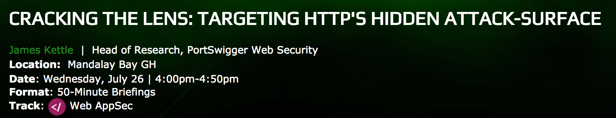
Notes:
“ accidentally exploit my own ISP” Kettle not fooling me.
Todays web is a complex mesh of transparent systems. James figured out that malformed requests and esoteric headers allowed bad stuff to happen (and access to stuff that shouldn’t be there)
But wait, there is more. Covert comms by an ISP, a colombian ISP, and a plugin release for Burp. Yes yesy yes

Slide 11
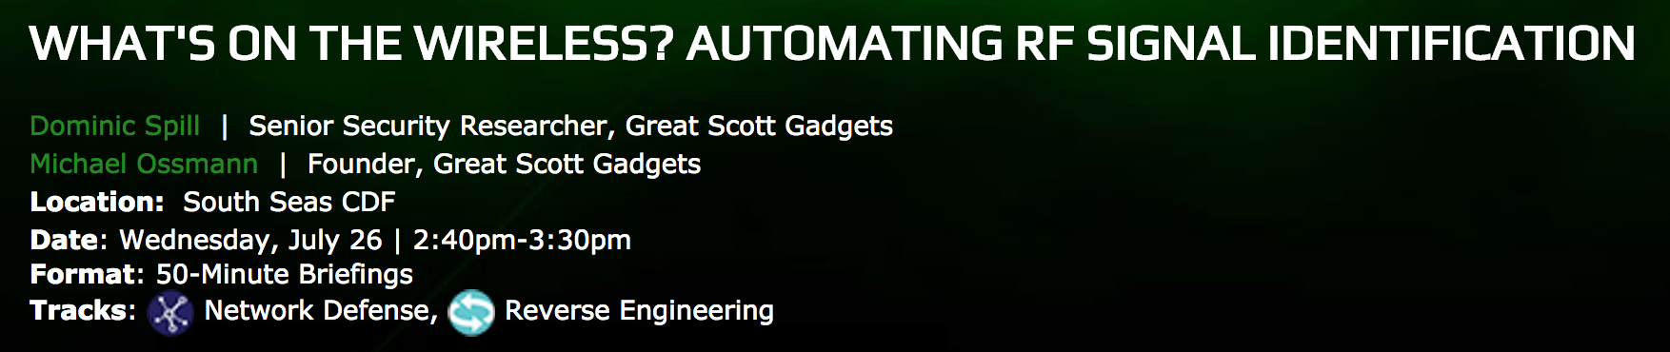
Notes:
Wireless is everywhere, monitoring this tsunami is hard and often unmanageable. Michael and Dominic have created OS tools to monitor signals, drill down to individual. Then combine with OSINT data to build up pictures.

Slide 12
