Slide 1



iOS App Integrity – Got Any?
August 2014
Research Team: Gregg Ganley(PI) and Gavin Black

Slide 2

About MITRE
Not for profit, working in the public interest
MITRE does not manufacture products, enabling us to provide conflict-free guidance
MITRE operates several FFRDCs
  DoD, FAA, IRS, VA, DHS, U.S. Courts
MITRE invests in an independent R&D (IR&D) program to ‘look ahead’ for our sponsors

Slide 3




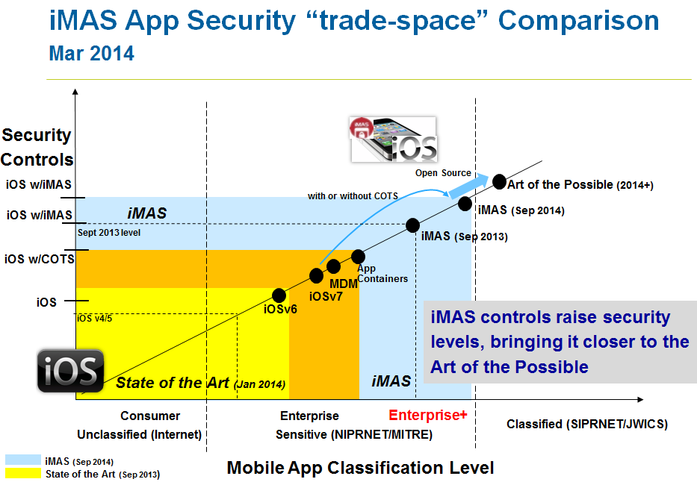
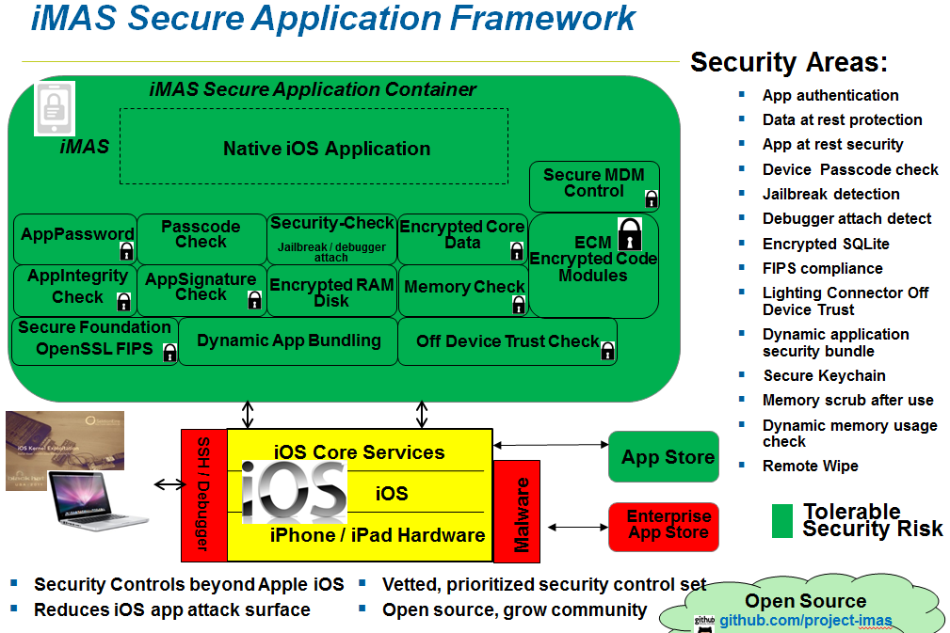
iMAS iOS Mobile Application Security
Gregg Ganley
Gavin Black
Problem
iOS is considered secure, but out of the box security is not enough
Simple device passcodes enable easy compromise of applications and data
Solution
Additional security controls beyond Apple
Patient/employee empowerment with secure mobile
Reduce iOS app attack surface
Extends security with or without MDM and commercial solutions
Raise iOS app security levels - closer to the Art of the Possible
Open source available
  project-imas.github.com

Slide 4
iOS Encrypted Code Modules (ECM)
Bottom Line Up Front
iOS Static App attacks are very common
Code injection and binary patching can compromise app
Application Integrity is critical to thwarting these techniques
Implementing App Integrity is difficult
iMAS introduces ECM
Next steps with ECM

Slide 5
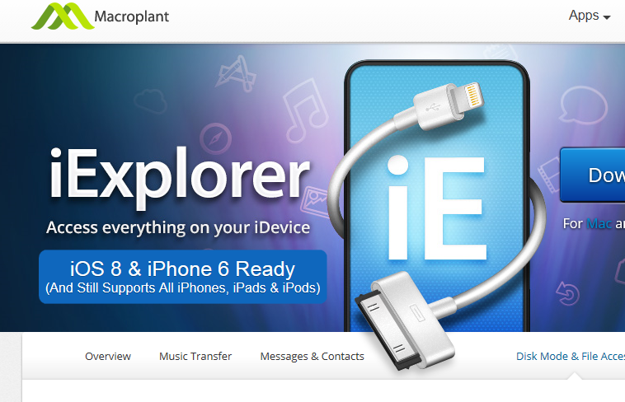
iOS Static App Attacks
Goals
  piracy, reverse engineering and tampering
Free tools and commercial tools are available
  iExplorer makes it easy to copy executables from device to laptop
Attackers often can analyze, copy, and change binary at will
Can determine security algorithm
Knowledge used to side-step security measures

Slide 6

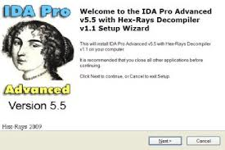
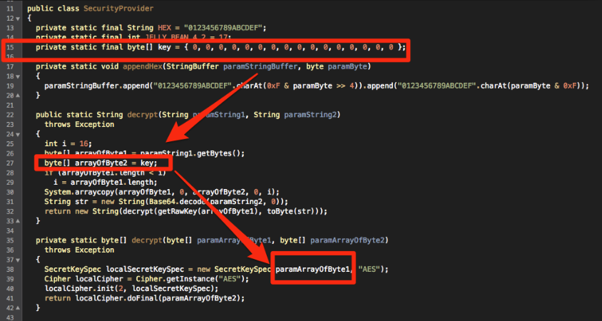
Static App Attacks
Process
iOS Apps Decompiled to source
Algorithms understood
Binaries patched
Security side-stepped

Slide 7
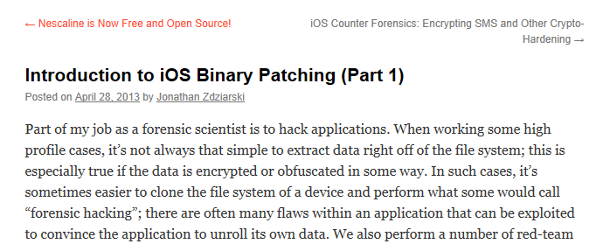

Code Injection and
Binary Patching
Binary patching
  Jon Zdziarskis blog offers iOS Binary patching
  http://www.zdziarski.com/blog/?p=2172
  Applidium
  http://applidium.com/en/news/securing_ios_apps_patching_binaries/
Used to nullify security code and exfiltrate data
Vectors:
  Background malware and physical device attacks

Slide 8
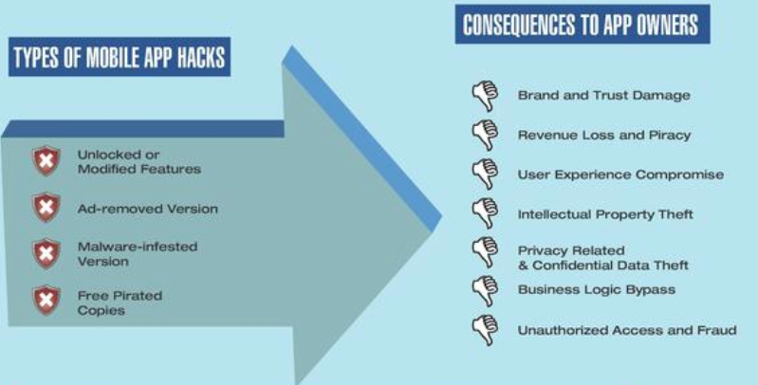
Consequences of Static Attacks
IBM Arxan NetworkWorld article June 12, 2014
http://www.networkworld.com/article/2362604/wireless/ibm-and-arxan-tackle-the-next-big-security-threat-mobile-apps.html

Slide 9
Introducing iMAS –
Encrypted Code Modules

Slide 10




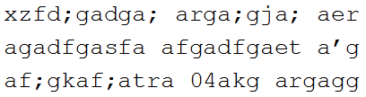


iMAS Encrypted Code Modules (ECM)
Protection against static attacks
Isolate sensitive algorithms into dynamic libraries
Deployment targeted for enterprise App Store not App Store
Encrypt files and bundle as part of iOS app IPA file
Decrypt and use at run-time
Protects against static application attack
Ciphertext DynamicLib file
Plaintext
.dylib
Xcode
app_integrity_check()
{
read_file()
calc_checksum()
confirm_integrity()
}
bundle
ECM
DynamicLib
Bundler
iOS App
ECM
DynamicLib
Sensitive Algorithm
Protected Functionality
Secured with ECM App Key

Slide 11
ECM – Encrypted Code Modules
Concept 1/3
Build Time
Xcode
ECM
DynamicLib
Builder
ciphertext
DynamicLib
Plaintext
.dylib
Protected Functionality
Secured with ECM App Key

Slide 12
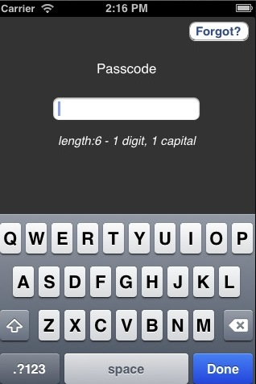
ECM – Encrypted Code Modules
Concept 2/3
ECM built into iOS App
AppPassword
Xcode
At Install user enters ECM App Key (EAK)
EAK is encrypted w/User iMAS AppPassword
iOS App
ECM
DynamicLib
iOS App
ECM Decoder
ECM
DynamicLib
ECM Decoder
iMAS Security

Slide 13

ECM – Encrypted Code Modules
Concept 3/3
On Device
At Rest:
In Use:
AppPassword
Critical Functionality Encrypted
iOS App
iOS App
ECM
DynamicLib
ECM
DynamicLib
ECM Decoder
ECM Decoder
iMAS Security
iMAS Security
Invulnerable to Decompiling
Critical Functionality Unlocked
User Enters app password

Slide 14
ECM Advantages
Protects the code against static analysis
  Forces an attacker to perform a dynamic attack
As long as the code is encrypted, it is protected against targeted tampering
Apps with ECM can
  Protect sensitive algorithms
  Protect Intellectual Property
  “checksum themselves” to ensure binary was not patched
  Protect security controls themselves – I.E. Memory Security

Slide 15
App Integrity on iOS
Cryptographic hash functions can be leveraged to verify an Apps binary integrity
  checksum
Difficult to:
    Secure the known good values of the hash
    Secure the algorithm, specifically
      Read
      Call to calculate checksum
      Compare checksum values
Mitigates against app tampering

Slide 16
Demo

Slide 17
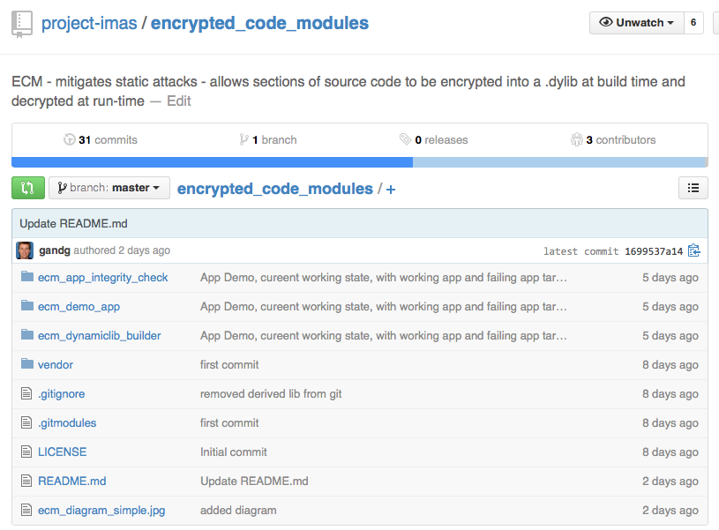
iMAS ECM available on Github
Open Source available Aug 4, 2014
https://github.com/project-imas/encrypted_code_modules

Slide 18
Questions?
iMAS - iOS Mobile Application Security
Github:
  https://project-imas.github.com
POC:
  MITRE, Bedford MA
  Gregg Ganley
    781-271-2739
    gganley@mitre.org
  Gavin Black
  781-271-4771
  gblack@mitre.org
  Please !
  Visit and Discover
  Download and Experiment
  Feedback and push requests

