Slide 1
Heybe – Penetration Testing Toolkit
BlackHat Arsenal 2014 - USA

Slide 2
Agenda
Pentesting Overview
Heybe
Fener
Levye
SeeS
Kacak
DepDep

Slide 3
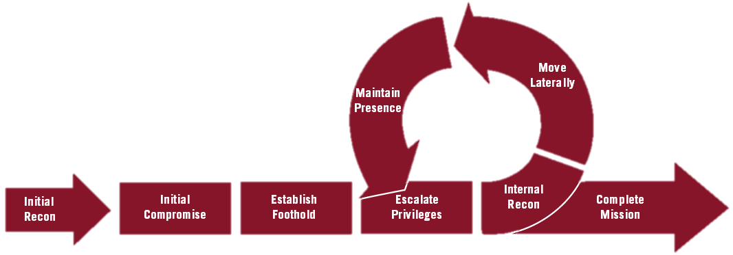
Penetration Test Phases

Slide 4
Pentest Types
Internal Pentest
External Pentest
Web Application Tests
Database Test
Social Engineering
DDoS Tests
Active Directory
Wifi Tests
…

Slide 5
Some Problems During Pentests
Very large networks
Limited time
Forgetting to save results
  Scan reports
  Screenshots
Non standard Nmap parameters
Bruteforce unusual applications

Slide 6

HEYBE

Slide 7
HEYBE
Open source toolkit for pentest automation
Code available on Github
https://github.com/heybe
https://github.com/galkan/sees
https://github.com/galkan/depdep
https://github.com/galkan/sees
https://github.com/galkan/kacak
https://github.com/galkan/levye
https://github.com/galkan/fener
Published at Blackhat USA 2014

Slide 8
WHY?
Automate and speed up boring/standard steps
More time for fun like SE
Standardize test results
Save results for reporting

Slide 9



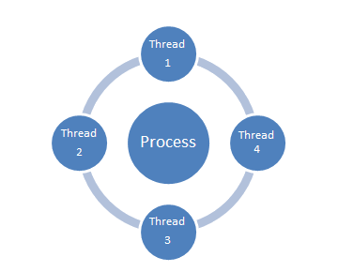


HOW?

Slide 10

WHAT?

Slide 11





Penetration Test Phases – Heybe

Slide 12
Fener
Information Gathering & Recon Tool
https://github.com/heybe/fener
3 Different Recon Methods
  Active Scan
  Passive Scan
  Screenshot Scan
DB Support

Slide 13
Fener – Active Scan
Leverages Nmap for active port scanning
Custom config file for scan parameters
  Ports
  NSE Scripts
Save scan results with standard report name
Multiple Nmap scans
  Ping Scan
  Service & OS Scan
  Script Scan

Slide 14
Fener – Passive Scan
Stealth network recon
Passive traffic capture
Arpspoof MitM support
Traffic saved in pcap file
Valuable information extracted from traffic
  Hosts
  Ports
  Windows hostnames
  Top 10 HTTP hosts
  Top 10 DNS domains

Slide 15
Fener – Passive Scan
Man In The Middle
Network traffic capture

Slide 16
Fener – Screenshot Scan
PhantomJS headless webkit
Web page discovery
Screnshots from commandline
Standard screenshot filenames
Offline examination
Pentest report

Slide 17

Crowbar
Brute Force Tool
https://github.com/galkan/levye
Supported protocols
  OpenVPN
  Remote Desktop Protocol (with NLA support)
  SSH Private Key
  VNC Passwd
Reporting
Debug Logging

Slide 18
SeeS
Social Engineering Tool
https://github.com/heybe/sees
Send targeted SE mails in bulk
HTML mail body
Multiple attachment
Local/Remote SMTP server

Slide 19
DepDep
Post-Exploitation Tool
https://github.com/heybe/depdep
Discover sensitive files in network shares
Works with Windows SMB shares
Can search sensitive information within file name and file contents

Slide 20

Kacak
Active Directory Attack Tool
https://github.com/heybe/kacak
Leverages Metasploit & Mimikatz
Hunt for domain admins in Windows AD Domain
Metasploit automation with MSFRPCD

Slide 21
Summary

Slide 22
HEYBE
Bahtiyar Bircan (bahtiyarb@gmail.com), Gökhan ALKAN (cigalkan@gmail.com)
https://github.com/heybe
https://github.com/galkan/sees
https://github.com/galkan/depdep
https://github.com/galkan/sees
https://github.com/galkan/kacak
https://github.com/galkan/fener
https://github.com/galkan/crowbar

