Slide 1
Manna From Heaven
Improving the state of rogue AP attacks

Slide 2
Turn your wifi off!
Our intention is to demonstrate our research findings, not to cause any damage. We have taken precautions, but some danger is inherent to such live demos. Please turn off your wifi now if you would not like to be involved. If you decide not to, then you do so at your own risk and we take your continued presence as your consent.

Slide 3

SensePost
We
Hack | Build | Train | Scan
Stuff
Daniel Cuthbert
Daniel@SensePost.com
@dcuthbert

Slide 4

Why Wifi
Notes:
Everybody loves hacking wifi, first skiddie project
You’re guaranteed to get something some of the time
It’s ubiquitous
It gives you access to lots of cloud services
You can use 20yr old ethernet hacks

Slide 5

Creds from the Sky
Notes:
We have vulnerabilities at every layer:
Get devices to connect
Dino dai Zovi & Shaun Mcauley – 2004, KARMA
Crack auth
Josh Wright – 2003, asleap then Moxie Marlinspike – 2013, cloudcracker
Joshua Wright and Brad Antoniewicz – 2008, Freeradius-wpe
We can intercept creds over the network
Dug Song – 2000, dsniff
Rob Graham – 2007, Hamster & Ferret
Eric Butler – 2010, Firesheep
We can downgrade/intercept SSL
Moxie Marlinspike – 2009, sslstrip & sslsniff,

Slide 6

The Current State
Notes:
Get devices to connect
Dino dai Zovi & Shaun Mcauley – 2004, KARMA – old code, less probing, some device need more
Crack auth
Joshua Wright and Brad Antoniewicz – 2008, Freeradius-wpe – old code, pita to run, only targets one network, separate tool
Josh Wright – 2003, asleap then Moxie Marlinspike – 2013, cloudcracker
We can intercept creds over the network
Dug Song – 2000, dsniff
Rob Graham – 2007, Hamster & Ferret
Eric Butler – 2010, Firesheep
some of these tools barely work, not been updated for modern comms, ssl defeats them
We can downgrade/intercept SSL
Moxie Marlinspike – 2009, sslstrip & sslsniff, defeated by HSTS
If nearly every layer of our wifi stack is vulnerable:
Why can’t we just walk around
With creds falling from the sky?
http://www.fetchmyflyingmonkeys.com/blog/photo/thirst.jpg

Slide 8

Targeted Wifi Primer
Notes:
We’re talking wifi – 802.11a/b/g/n/ac in the 2.4Ghz or 5Ghz range
Not bluetooth, rfid, 3G etc.
3 types of packets
Management – Probes/Beacons
Control – RTS/CTS
Data – The goods
We’re looking at management

Slide 9
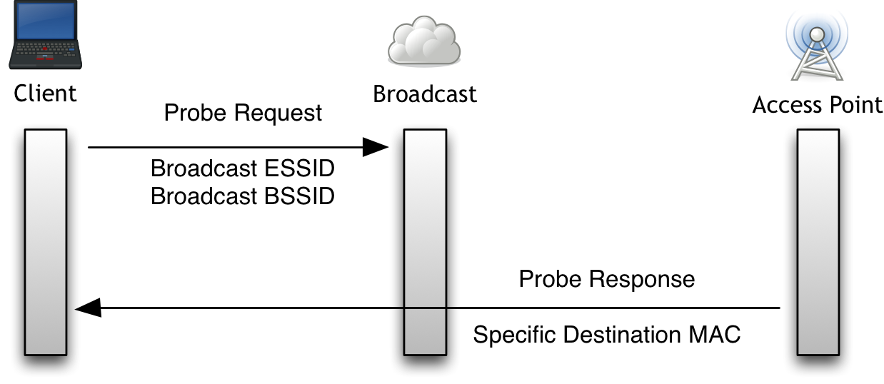
Finding Networks

Slide 10
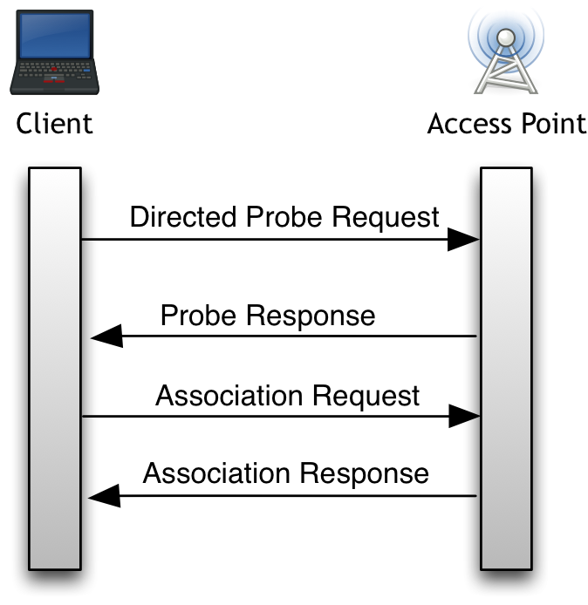
Simple Association
Notes:
We’ve ignored the authentication exchange
Important to note that this and the previous step are decoupled and the probe is repeated
If you click “save” or “remember” it gets added to your PNL
Client sends probe
Station responds to probe
Client sends authentication request
A formality, nobody uses shared key networks, all open
SSID sent in the clear, even if hidden
AP acknowledges authentication
Client sends association request
Contains capabilities e.g. rates
AP sends association response
Management Packets
Unauthenticated in Open Network

Slide 11
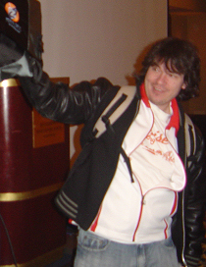

KARMA Attacks

Slide 12



How KARMA Works
Notes:
Device will probe for remembered nets (preferred network list [PNL]), even when not near them
We just respond as the normal network would
Hey “home network” you there?
Uh, sure, I’m “home network”
First presented in 2004 by Dino dai Zovi & Shane Macaulay
Modern implementations:
airbase-ng by Thomas d'Otreppe
Software only, no master mode needed
hostapd-1.0-karma by Robin Wood (digininja)
Used on the Hak5 pineapple
Networks/ESSIDs can have multiple APs (e.g. corporate nets)
BSSID doesn’t have to match
Devices need to switch APs as they move
Anti-spoofing done at higher level
WEP & WPA/2 PSK
AP & STA prove they know the key to each other)
EAPs
other proof, like TLS validation
Devices probe directly for networks on their PNL
We built snoopy off of this single flaw

Slide 13

Not so well anymore
Notes:
iOS devices significantly reduced the amount they probe since iOS 7
Android devices only connected when you explicitly joined the network
Didn’t show up in the available network list in modern android
Same for Linux (shared wpa_supplicant code)
Windows devices varied greatly across versions
Only Macs (OSX) seemed to auto-connect to any of these networks!

Slide 14
Build PNL & Respond to Broadcasts
Notes:
Turns out our AP needs to respond to the broadcast probe as well as the directed probe
It also turns out we can send multiple probe responses for different networks (ESSID) from the same BSSID
Process
Watch for directed probes
Build per-MAC view of PNL
Respond to a broadcast probe with directed responses for each network in PNL
This increases our karma attack significantly!
Implemented in our hostapd mod included in MANA

Slide 15
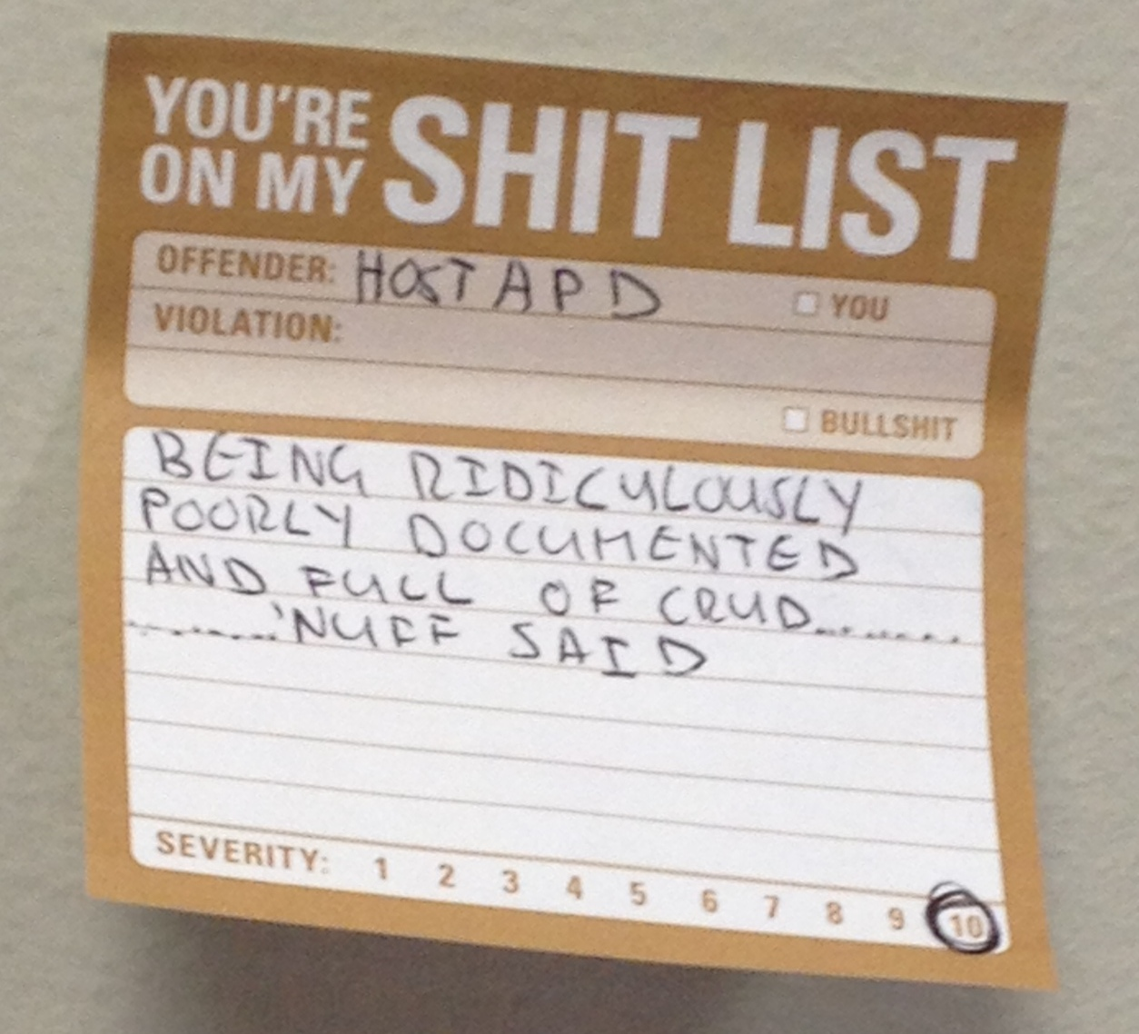
Disclaimer

Slide 16

On Probes
Notes:
Snoopy screwed us (yay)
iOS devices barely probe
iOS has promised to introduce MAC randomisation on probe (not seen yet)
Android had changes committed in July 2014 to reduce probes (fix low-power offload probing)
wpa_supplicant got the patches, so Linux too
Devices with hidden networks on their PNL need to probe for them all the time
But iOS devices don’t
This is impossible!
Turns out, iOS only probes for hidden nets when at least one hidden network is in-range

Slide 17
Hidden Networks & Loud Mode
Notes:
Run a hidden network, or beacon out hidden network frames with the normal beacon
Also, deauth users from currently connected APs to force re-scan
Rely on other devices to leak network names (e.g. their laptop/tablet, co-workers, fellow airport travellers etc.)
“loud mode” changes mana’s behaviour to not track PNL per device, but to re-broadcast all networks to all devices
Very noisy!

Slide 18

Secure Networks
Notes:
No support for secured networks in KARMA
Devices expecting a “secured” network won’t connect
User can manual connect
Android shows as different network
iOS shows as open, can click with no warning
OSX shows as open, connecting gives warning
We already know we can respond with multiple probe responses for different networks from a single BSSID
So, we can respond with multiple probe requests with different security settings
Some devices will connect to the one they have in their PNL
But, there’s a problem …

Slide 19
Auto Crack ‘n Add
Notes:
PEAP we can capture the MSCHAPv2 challenge/response if no cert validation
Currently, people use freeradius-wpe by Joshua Wright and Brad Antoniewicz
But, hostapd has it’s own RADIUS server
Now, so does mana, no need to run a separate server
(initial patch from Brad)
WPA/2 we can capture the first 2 parts of the handshake and extension for later
Send them for cracking with your favourite tool
CloudCracker (chapcrack), Asleap, coWPAtty, aircrack-ng, hashcat, john
Add the results back to manna!
i.e. auto create a network with the correct security setting, PSK key or EAP user:password combination
Also, CREDS FROM THE SKY!
This only works on “easy” creds, hard take too long

Slide 20
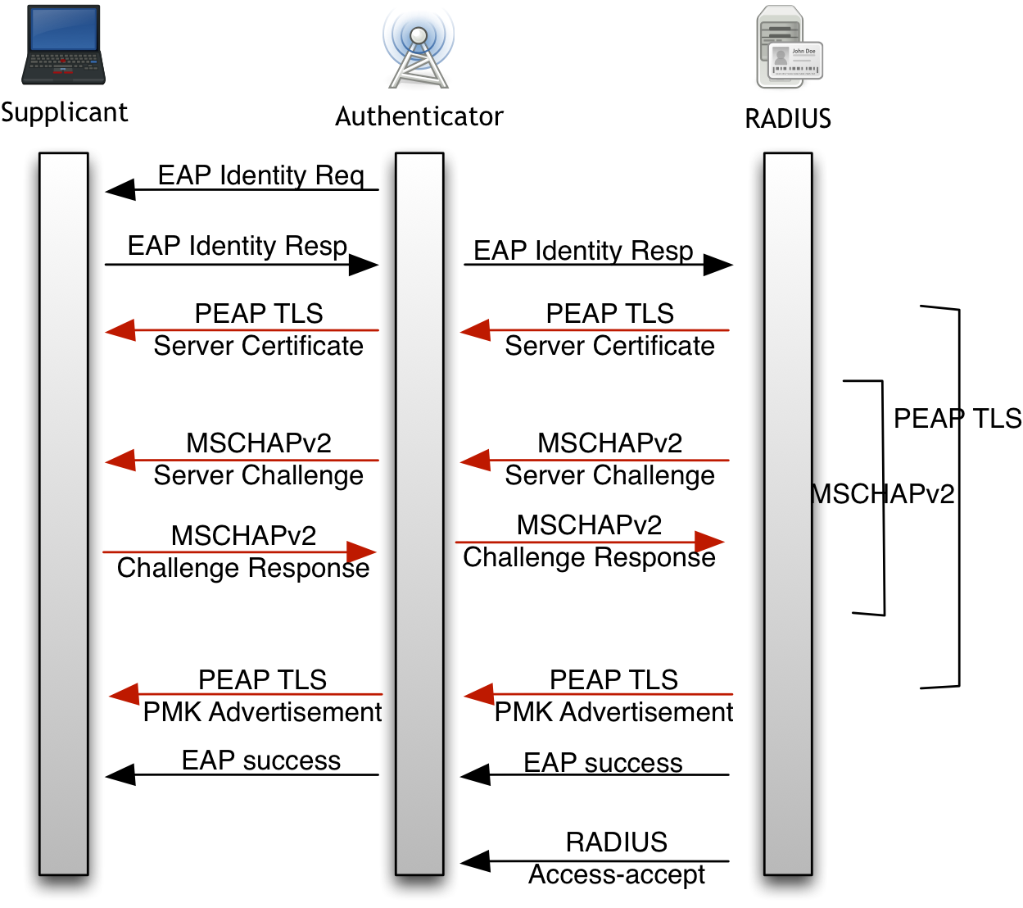
PEAP

Slide 21

Man In The Middle
Notes:
Getting clients to connect is only half the battle
Benefits of MitM are rapidly declining
Devices try to check if connection is legit
Tools no longer work (dsniff, firesheep, etc.)
Karmetasploit only gives us a handful of mail creds
HSTS defeats sslstrip
Mobile Apps auto cert validation defeats SSL MitM
Cert pinning ruins everything

Slide 22

Non-SSL Protocols - SSLSplit
Notes:
Daniel Roethlisburger

Slide 23

Fake It until you Make It
Notes:
Needed for MitM with no-upstream (e.g. on planes, down mines, in faraday cages ;)
Devices make a request to a site on public Internet to check if online
iOS devices hit 1 of over 200 sites with a random request
BlackBerry, Android, Windows all make a single request to a known destination
MANA includes bundle of apache sites that implement all of these

Slide 24

Captive Portal SE
Notes:
We want creds dammit!
Fake captive portal, designed to gather them
Tricks
Don’t interfere with normal comms (so we can still mitm auto interactions)
Use WISPr to get browser open early
Provides chance for cert profile push & explanation
Provide option to go away so user can continue surfing
Provides a beef hook
Ask for creds using OAuth-lookalike
Our take included in MANA

Slide 25

Side Loading Evil Certs
Notes:
Config Profiles allow tons of changes to the device, including
New root CA, for MitM
New open wifi networks to keep KARMA going
Ability to prevent it’s removal
Can push these to the device over HTTP (no need for mail SE, but could do that too)
Requires users hit install and type their passcode
Tough sell ☹
But can prevent removal after that
Allows much better MitM with new root CA
http://www.lacoon.com/blog/2014/07/security-disclosure-googles-ios-gmail-app-enables-threat-actor/
Doesn’t defeat cert pinning though

Slide 26
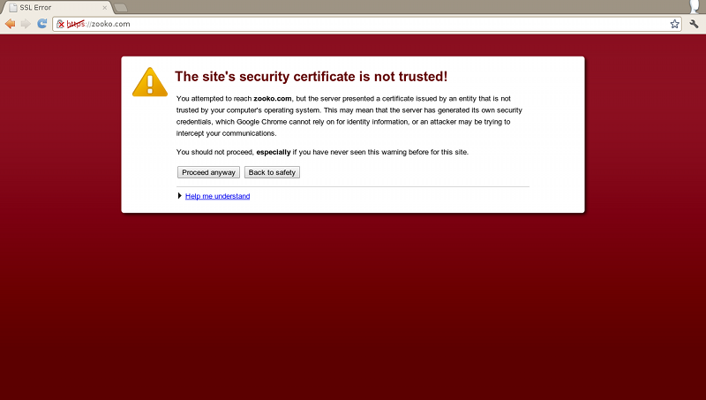
HSTS Partial Bypass by LeonardoNVE
Notes:
Updates to sslstrip by LeonardoNVE @ BlackHat Asia
Includes intercepting DNS server, dns2proxy
Process
Browser requests http://www.google.com/
sslstrip returns redirect to wwww.google.com
dns2proxy mirrors DNS for www.google.com -> wwww.google.com
sslstrip rewrites links from www.google.com to “alternate” domains
Browser has no HSTS setting for wwww.google.com
Client continues in plaintext

Slide 27

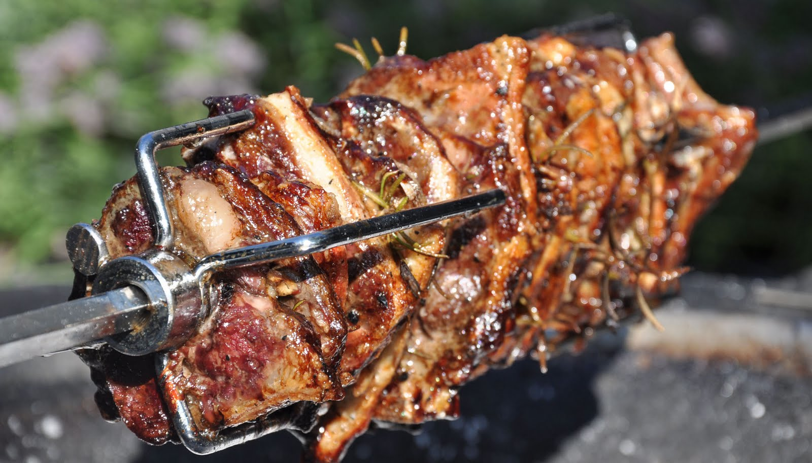
FireSheep ReBorn as FireLamb

Slide 28
Lots of MitM
Online Check Bypass
Creds
Cookies (FireLamb)
Cert Sideloading
HSTS Partial Bypass
Captive Portal SE

Slide 29
Creds from the Sky

Slide 30
More Info
Blog: www.sensepost.com/blog
Tools: github.com/sensepost
github.com/sensepost/mana
github.com/sensepost/hostapd-mana
github.com/sensepost/firelamb
github.com/sensepost/crackapd
github.com/sensepost/sslstrip-hsts
SlideShare: slideshare.net/sensepost

